Slide 1
Powerful CNN

Slide 2
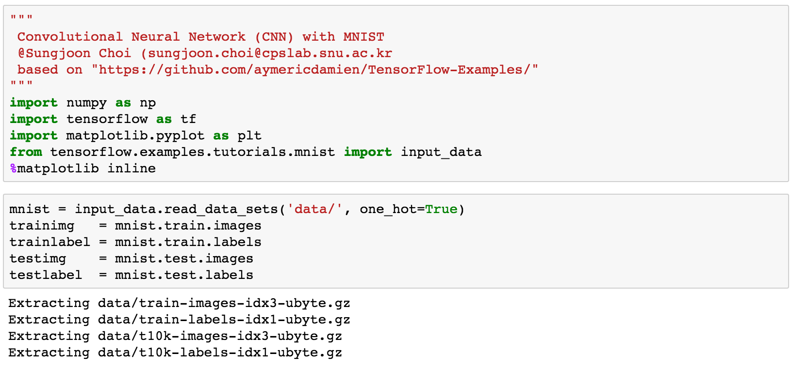
Load packages

Slide 3
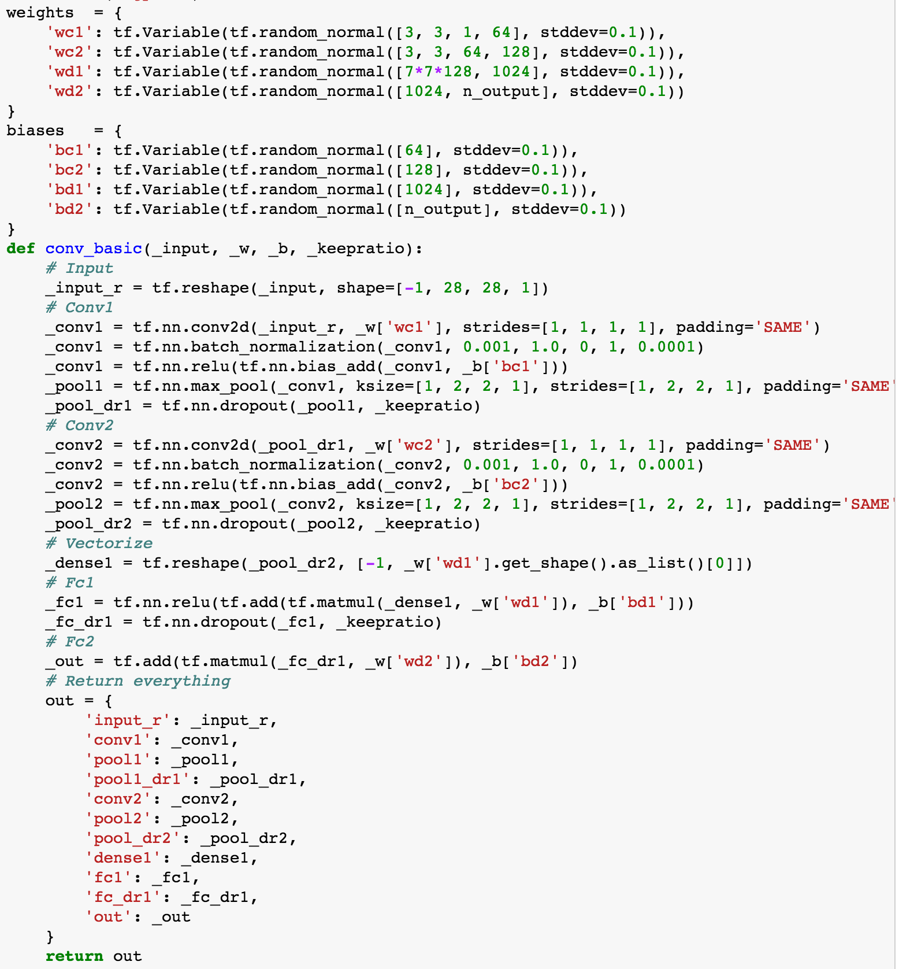
Deeper CNN

Slide 4
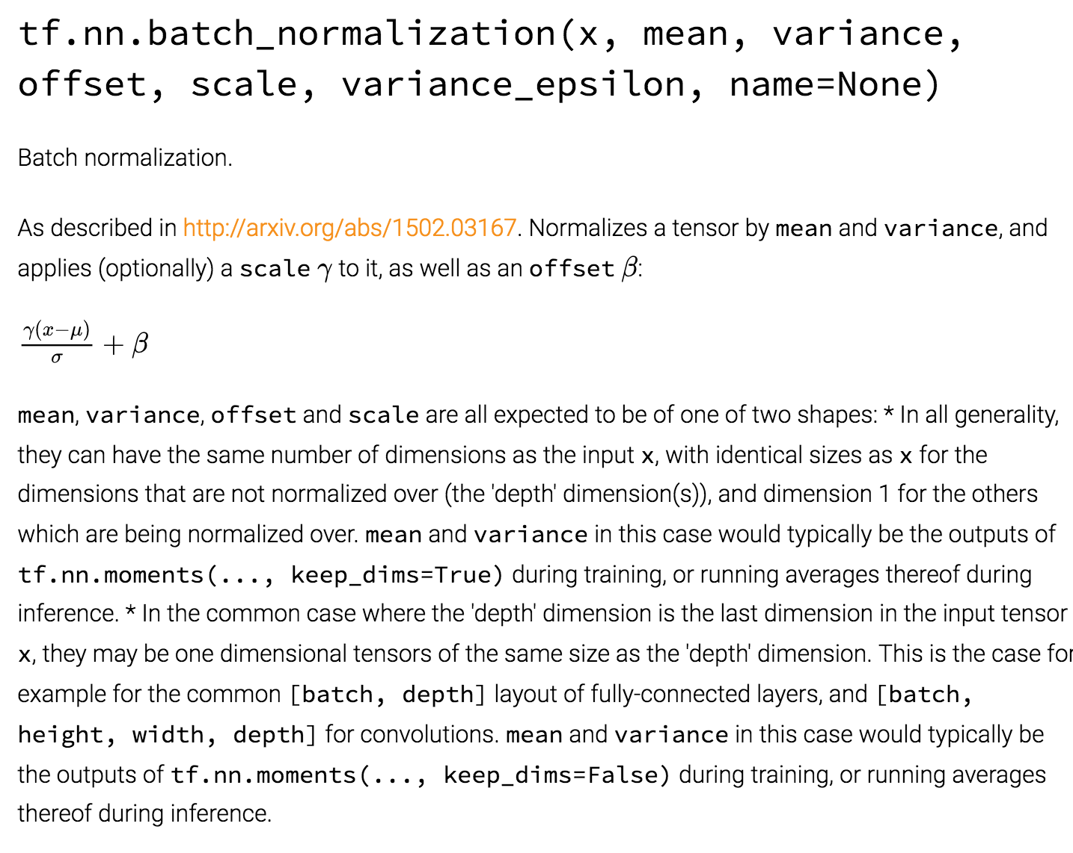
Batch normalization

Slide 5
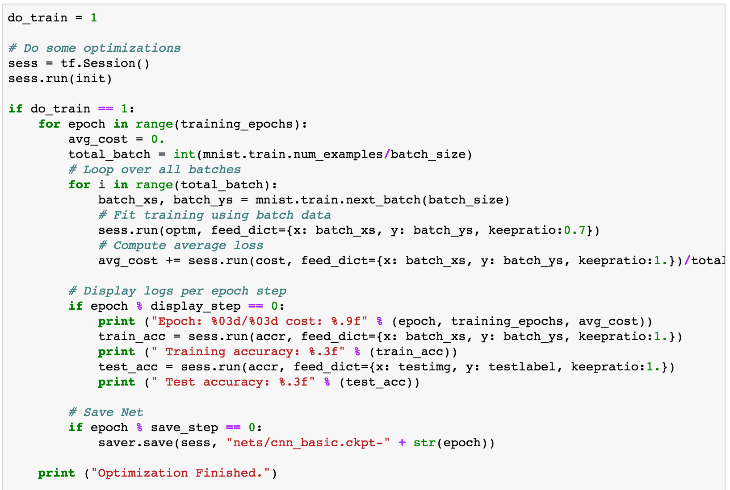
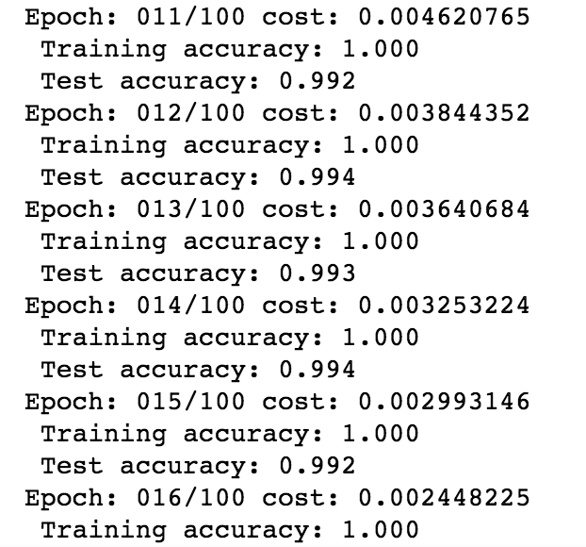
Training is the same

Slide 6

But the results are..

